Slide 1
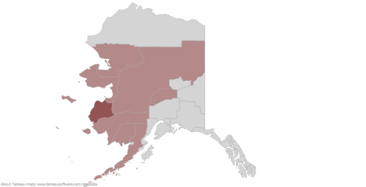

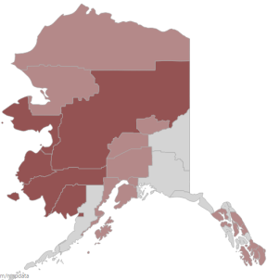
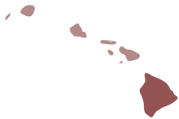




Poverty in America: The intersection of disability and housing
Derek Nord, Kelly Nye-Lengerman, & Kristin Hamre
Institute on Community Integration
Introduction
Data
Conclusion
Problem
Poverty affects over 24 million working age Americans, or 13.4% of the 20 to 64 year old population. Those affected often times lack sufficient resources to meet their day-to-day basic needs. Individuals with disabilities are disproportionately affected by poverty. In fact, nationally, people with disabilities experience poverty at over twice the rate of their non-disable peers.
What is Poverty?
Poverty is defined at the percent of people that fell below the poverty threshold in the last 12 months. One’s poverty threshold depends on the size of their family and number of children. The poverty threshold for a single individual is $11,945, and for a family of four with two children the threshold is $23, 288.
Housing & Community
Access to quality housing options is a fundamental need for individuals with disabilities. Housing is a vital component of an individuals membership in their community. Housing provides access to the community and a multitude of social and economic benefits. Barriers related to vacancy rates, occupancy mix, rental prices place a disproportionate burden on individuals with disabilities.
Data Sources
American Community Survey(ACS), 2012 which is non institutionalized working aged adults bewtween20-64. The data also included ACS 5 year county poverty estimates from 2008-2012.
Poverty Rates by County
Fig. 1 Poverty rate for people without disabilities Fig. 2 Poverty rates for people with disabilities
0% 37.5%+
Occupancy & Rental Prices
One average counties with higher density of rental properties have higher rates of individuals with disabilities. This relationship is strongest in the Midwest. On average counties with higher rental prices have lover concentrations of individuals with disabilities living in poverty. This negative relationship is worst in the southern region.
Fig. 3 Disability poverty rate by renter occupancy rate Fig. 4 Disability poverty rate by median rent
Discussion
Poverty is significant issue for individuals with disabilities. This is compounded by the fact that access to affordable housing is extremely limited in the communities where they live. In addition, housing discrimination against individuals with disabilities represents the largest number of housing discrimination cases in the United States (National Fair Housing Alliance, 2013). The National Fair Housing Alliance (2013) estimates there are over 11,000 cases of housing discrimination each day. This along with the data provided reflect the local challenges of affordable housing for individuals with disabilities living in poverty.
Future Directions
Effective policy development and advocacy around housing issues requires an understanding of how key community factors impact people with disabilities living in poverty.
Local policy makers, advocates, and organization that are familiar with their communities are well positioned to begin to tackle the complex nature of this problem.
References
Cooper, E., O’Hara, A., Singer, N., Zovistoksi, A. (2013) Priced out: The housing crisis for persons with disabilities. Boston, MA.
National Fair Housing Alliance. (2013). Modernizing the Fair Housing Act for the 21st Century. Washington, DC. Retrieved from http://www.nationalfairhousing.org/Portals/33/2013_Fair_Housing_Trends_Report.PDF
U.S. Census Bureau. (2013). Table B23024: Poverty status in the past 12 months by disability status by employment status for the population 20-64, 2008-2012 American Community Survey 5-year estimates. Retrieved 1/13/14 from http://factfinder2.census.gov/faces/nav/jsf/pages/index.xhtml.
U.S. Census Bureau. (2014). Table DP04: Selected housing characteristics 2008-2012 American Community Survey 5-year estimates. Retrieved 1/13/14 from http://factfinder2.census.gov/faces/nav/jsf/pages/index.xhtml.

